Slide 1
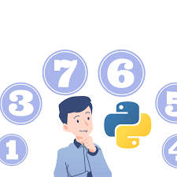
Computer-Science: Mini Project
Project Title: Number-Guessing-Game
Objective of this Project:
To develop a Python game which asks the user to guess the number within the given number of turns according to the chosen difficulty level

Slide 2
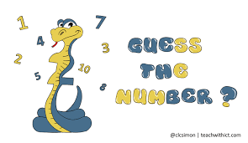

Introduction:
Welcome to the Python Number Guessing Game!
Engage your logical prowess in this interactive challenge
Discover the hidden number within the range of 1 to 100.
Choose your adventure with three distinct difficulty levels: easy, medium or hard.
Navigate through limited attempts as you strategize your way to victory.
Get ready for a cerebral exercise in this intriguing Python gaming endeavor.

Slide 3
Key Functions:
check_answer(guess,answer,turns):
Compare user;s guess with the actual answer.
Deducts turns and provides feedback
Notifies on correct guess.
set_difficulty():
Prompts for difficulty level selection.
Sets attempts based on level.
game():
Orchestrates the entire game.
Initializes, generates random number, and starts the guessing loop.

Slide 4
Algorithm:
Following is the algorithm of our Python Number Guessing Game Project:
Display Welcome Message:
Display a welcome message to greet the player and introduce the game.
Generate a Random Number:
Generate a random number between 1 and 100 to be guessed by the player.
Define Difficulty Levels:
Assign a set number of attempts (turns) for each difficulty level (easy, medium, hard).
Prompt User for Difficulty Level Selection:
Ask the player to choose a difficulty level (easy, medium, hard).
Set the number of attempts based on the chosen difficulty level.
Initial Game Loop:
Start a loop to manage the game flow until the player guesses the correct number or runs out of attempts.

Slide 5
6. Display Remaining Attempts and Get User Input:
Display the number of remaining attempts to the player.
Prompt the player to enter a guess.
7. Check user’s guess:
Compare the player’s guess with the randomly generated number.
If the guess is too high, provide feedback to the player (“Too high”).
If the guess is too low, provide feedback to the player (“Too low).
If the guess matches the number, congratulate the player for guessing correctly and end the game.
8. Decrement Attempt Count:
Decrease the remaining attempts count after each guess.

Slide 6
9. End Loop:
If the player guessed the number correctly, end the game with a congratulatory message.
If the player exhausts all attempts, end the game with a message revealing the correct number.
10. Game Over:
Display a game-over message, revealing the correct number if it wasn’t guessed.
This algorithm provides a step-by-step guide outlining the flow of the number guessing game from the initialization phase to the hame’s conclusion. Adjustments and additional features can be incorporated based on specific requirements or enhancements desired for the game.

